Slide 1
Module 3 Synthetic Curves Intro Hermite Cubic Curve

Slide 2
Any 3D space curve can be represented parametrically or non parametrically
The explicit non parametric representation of 3D curve is given by
x=x , y=f(x) and z=g(x)
The implicit non parametric representation of 3D curve is given by
F(x,y,z) = 0 and g(x,y,z)=0
Parametric representation of 3D curve is
X=x(u), y=y(u) and z=z(u) 0<u<1

Slide 3
Its necessary to build the entire curve by joining smaller segment of curves to each other, important characteristics while designing the curve include :
Control points, are necessary to control the shape of the curve, which could interpolate or extrapolate
Axis Independence, shape of curve should not change when coordinate system is transformed
Multiple values, line is a single valued function, whereas a curve is a multivalued function of a coordinate

Slide 4
Local and Global Control, part of the curve controlled regionally changes locally or change leads to global change by changing the control point position
Flexibility, analytical curves allow limited variety of shapes by changing the control points
Order of continuity, the order of the curve defines the the number of DOF that are necessary to uniquely define that curve. Order of curve equals the dof of that curve
order deg.
Point 1 0
Linear 2 1
Quadratic 3 2
Cubic 4 3

Slide 5
In CAD/CAM applications the smoothness of the curve is defined by its level of geometric continuity
When creating segments, the control of order of geometric continuity is important
C₀ zeroth order continuity means two curves join to form sharp corner at the joint
C₁ First order continuity, both curves are tangent at the point of intersection it tangent at end of one curve equals tangent at the start of the next segment
C₂ Second order continuity requires the curvature to be same ie radius of curvature at the end point of first curve and start of second curve is same

Slide 6
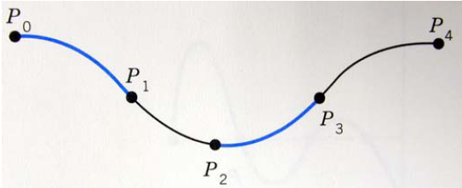
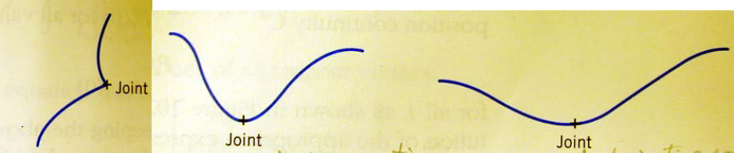
Hermite Cubic spline
They are a general form of curves that are defined through a set of vertices (points)
Piece wise interpolation of a cubic spline
It permits inflection within a curve segments ie the curve passes through the data points and therefore interpolates thro the data points
Each segment is approximated by a parametric cubic polynomial to maintain the C₂ continuity
A cubic polynomial generates C_{0,} C_{1,} C₂ continuity in the associated curves
C0 continuity: no gaps or jumps in a curve
C1 continuity: slope/tangent or first derivative continuity
C2 continuity: curvature or second derivative continuity

Slide 7

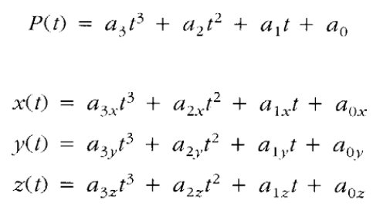
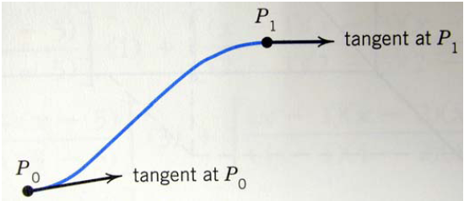
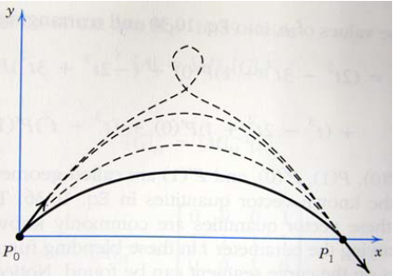
The parametric equation of a cubic spline is given by
where P(t) is a point on the curve.
The effect of change in magnitude of the Tangent vectors
Tangent vectors at the end of the segment

Slide 8
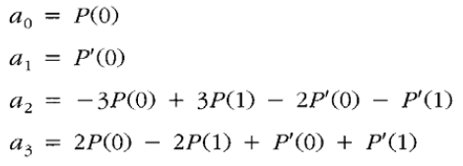
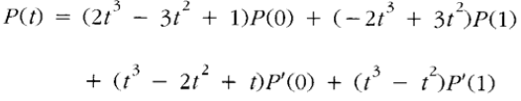
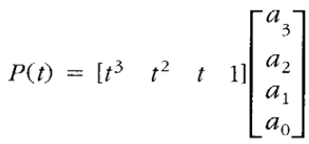
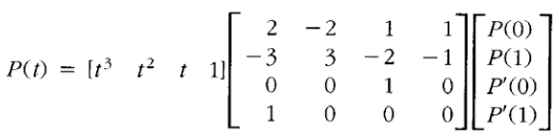
Solving the four equations simultaneously for the coefficients
Thus,
Blending fn or basis fn
In matrix form,
Coefficient matrix
Parametric matrix
Hermite matrix
Geometric coefficient matrix
P(t) = [t] [M_{H}] [p]

Slide 9
A cubic polynomial has four coefficients and thus requires four conditions to evaluate. Conditions could be
- combination of points and tangent vectors
A hermite Cubic spline uses the above condition
The property of tangent vector
- if both the vectors are constant, symmetricity is maintained
- if one changes though symmetricity is affected and the internal profile of the curve is affected

Slide 10

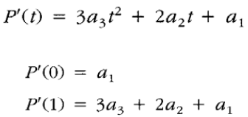
Conditions for Hermite interpolation
1. Endpoints: Two points are interpolated at a time by a parametric cubic
curve.
2. Tangent vectors: The direction of the tangent vectors establishes the
slopes (direction cosines) of the curve at the endpoints, and changes in
the magnitude of the vectors allow modification of the shape of the curve.
P(t), 0 ≦ t ≦ 1
the first derivation at the end points,

Slide 11
Three important characteristics of Hermite basis function
Universality (change in one data point, moves all the others)
Dimensional independence – they are identical for each of the three model space coordinates, because they are dependent on only u
Separation of boundary condition effects – they allow the constituent boundary condition coefficients to be decoupled from each other

Slide 12
Drawbacks of Cubic spline
Due to its global control characteristics, by changing the position of a data point, the entire shape of the spline changes
The curve is always cubic regardless of the number of data points
The curve is less smoother than other synthetic curves
Practically the direction and magnitude of the tangent vector is very difficult to know
More intuitive to only specific points

